Slide 1
Set Up
Ubuntu and ROS 2 Installation

Slide 2
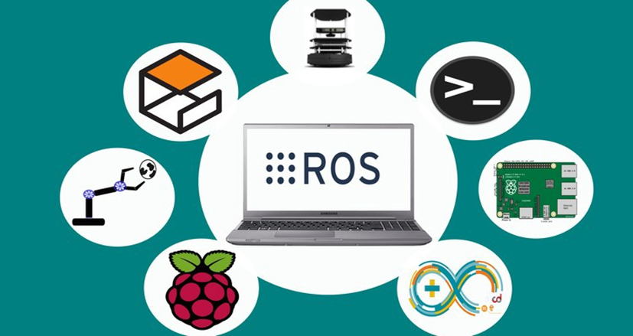
Introduction
For this course ROS 2 Humble will be used.
ROS2 Requires the installation of Ubuntu
MCR2 offers different alternatives
Install Ubuntu as Native OS
Install Ubuntu as Dual Boot
Install MCR2 Virtual Machine (VM) with preinstalled ROS2.
Install WSL

Slide 3
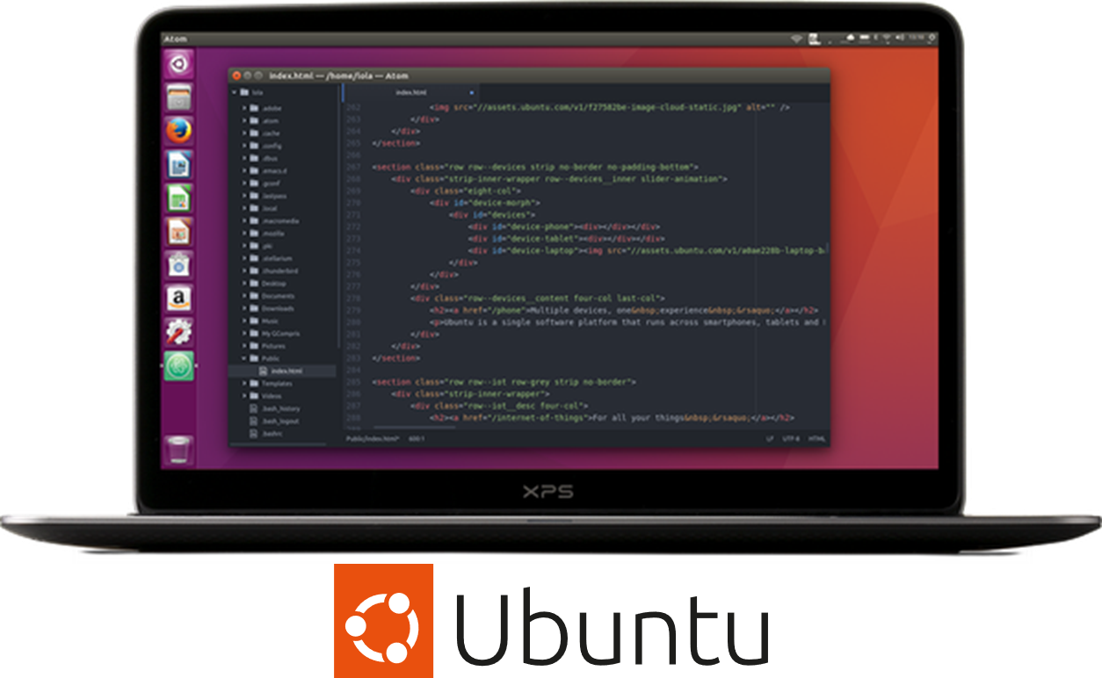
Getting Started with ROS
What do we need to start working?
Minimum Requirements*:
Processor: i5 or higher
RAM: 8 GB or higher
Storage: 20 Gb
Graphics: Dedicated GPU
*This requirements are the minimum for the activities designed.

Slide 4
Ubuntu 22.04
Installation

Slide 5

Getting Started with ROS
A new version of ROS is released with each Linux distribution. We will use ROS2 Humble in this course (released with Ubuntu 22.04).
ROS2 is a revision of the ROS (Robot Operating System), which aims to increase the framework's robustness for industrial applications and distributed systems.
Furthermore, ROS2 allows real-time applications.

Slide 6
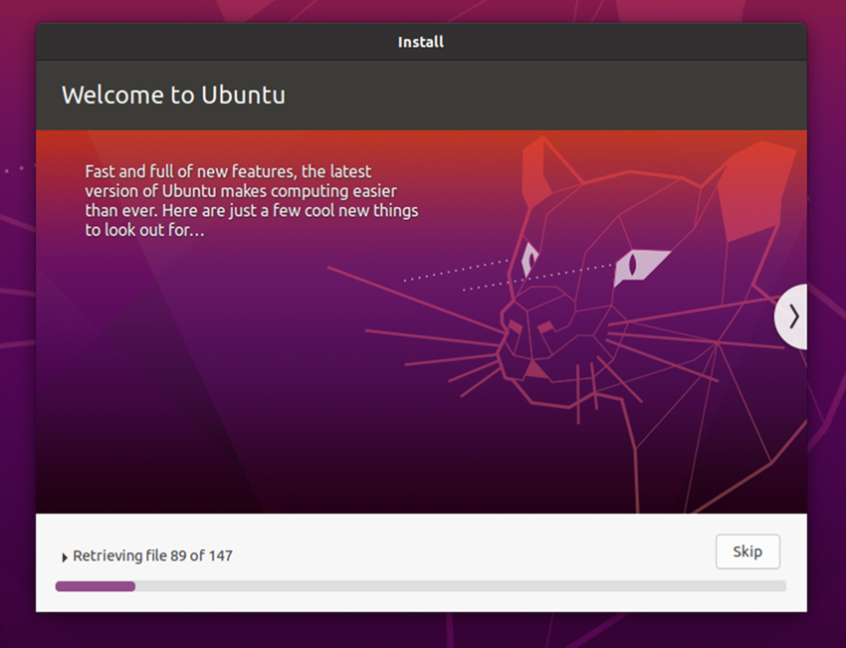
Installing Ubuntu
Installing Ubuntu
The recommended way of installing Ubuntu for robotics is as the main operating system or by dual booting it alongside the default Windows or Mac OS.
It can also run on a virtual machine, but this will limit features, and the performance speed could be affected.
If you are installing Ubuntu natively or dual-boot please go to the section Installing ROS2

Slide 7
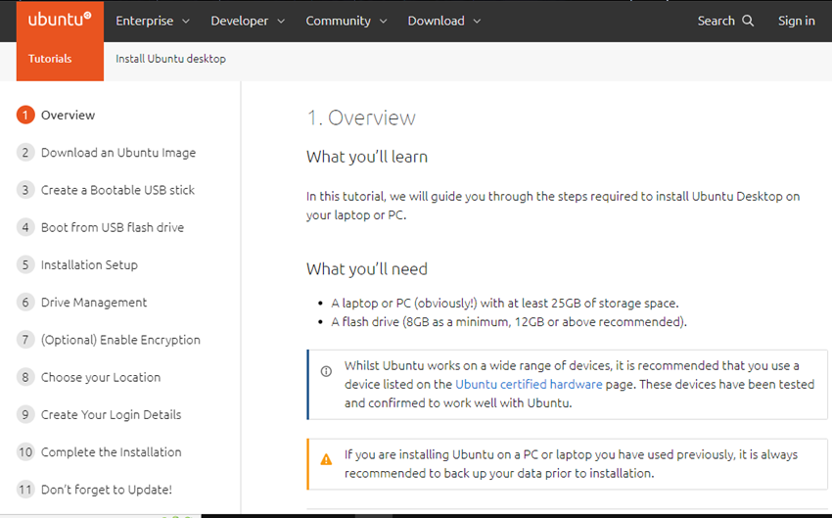
Installing Ubuntu: Native
Quick Installation Guide Ubuntu as Main OS
Follow the tutorial on the official ubuntu website. Download the ubuntu 22.04 image here.
On the left side of the webpage, all the steps for the installation are detailed.
Once you click on each step, the installation details are described in the right panel.
PROS: Easy installation, access in full to hardware.
“CONS”: Not possible if you need windows installed on the same machine.

Slide 8
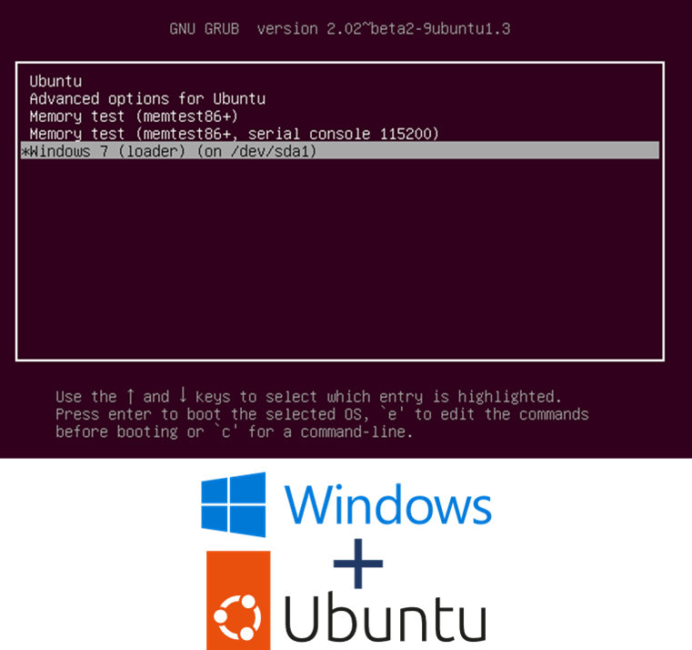
Installing Ubuntu: Dual Boot
Dual Boot Installation
This installation requires preparing the computer first. This may vary depending on the computer brand, but the main steps are:
Prepare the USB as the website indicates. (Step 1-4)
You may need to modify some parameters from the BIOS configuration.
Depending on how many partitions or how full the disc is, you may want to defrag and partition your hard drive using Windows. More info here.
Change the booting option from the computer and keep following the steps on the website.
PROS: Relatively easy install, access in full to hardware .
CONS: a problem if you must use windows and don’t have another machine.

Slide 9
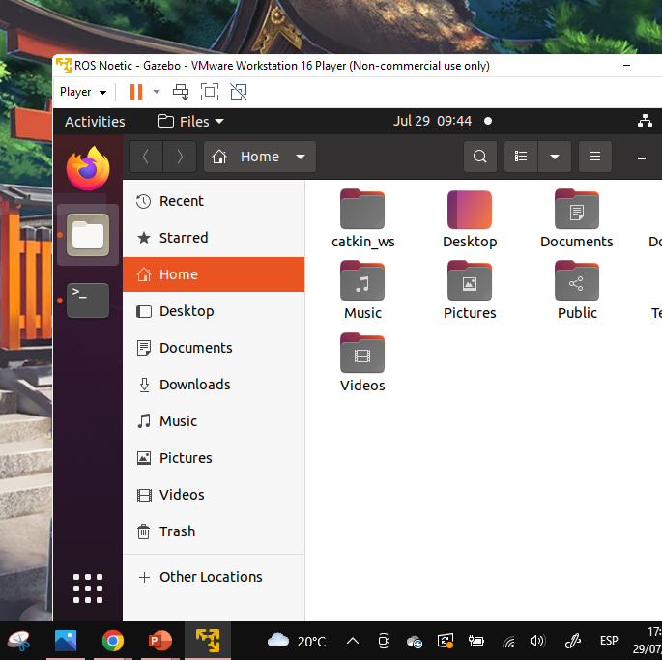
Virtual Machine
Virtual Machine vs. Standard Installation
A Virtual Machine (VM or guest OS) is an emulated Operated System done by software (Virtual Box and VMware most popular) installed in the main OS (host OS).
This could be helpful as a starting point (or a last resort), but it has some cons:
The host OS and guest OS share the same resources, affecting both operations (especially for heavy simulations).
VM requires drivers to access the peripherical (USB, Serial), which could be not supported or not fully working.
Sometimes the VM cannot have the same network as the host (main operative system), which would be a problem for ROS projects that require multiple devices that communicate with each other.

Slide 10
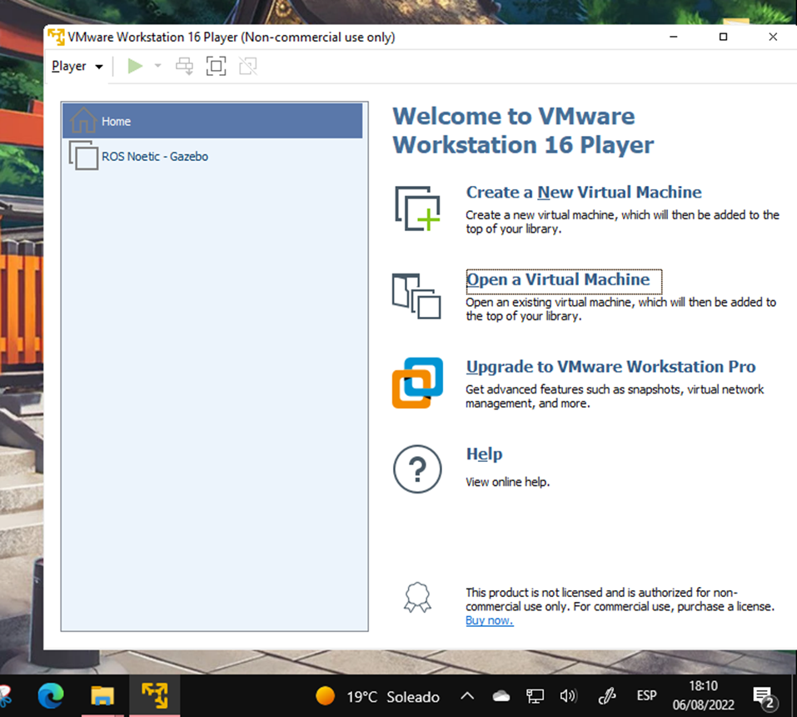
Installing VMware Player
Virtual Machine Installation
VMWare Player is a software that allows the user to run previously generated Virtual Machines and configure its settings.
MCR2 has prepared a ready to go Virtual Machine, you do not require to install ROS2.
Download the files:
VMware software executable Password: MCR2_2025!
(NOTE: This is a long file ( ~ 35GB).)
Install the VMware software (VMware-player-17.6.2-24409262).
Open software to finish the installation.
NOTE: Select personal “non-commercial” use

Slide 11
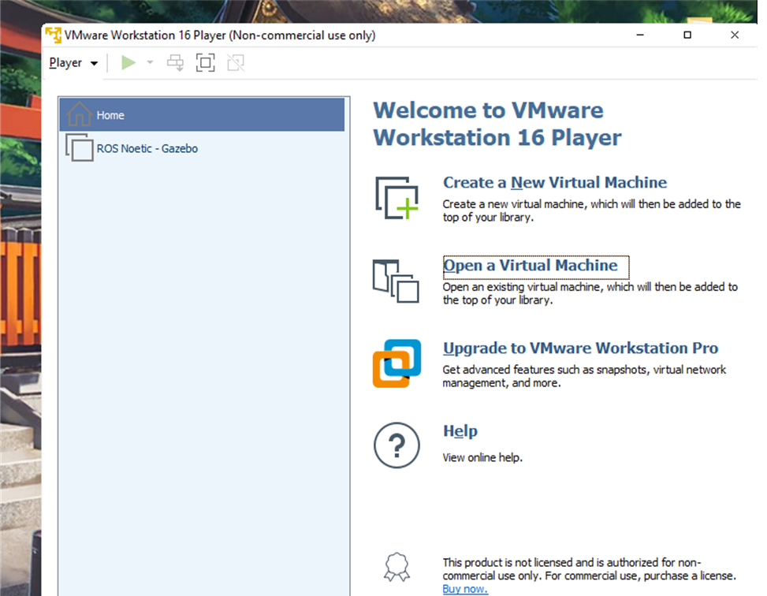
MCR2 Virtual Machine
Unzip the MCR Virtual Machine “VMs”
Click on “Open a Virtual Machine” and open the file you just unzipped (VMs) and select the file “UbuntuROS2” (you only must do this once).
The virtual machine will start to be set up.
NOTE: Choose the option “I copied it”
The virtual machine should start up with Ubuntu and ROS2 installed!
USER: MCR2
PASSWORD: student

Slide 12
ROS2: Humble
Installation

Slide 13
Quick installation guide for ROS
ROS Installation
Follow the tutorial on the official ROS website.
The ROS installation is done using the terminal.
Install “Desktop Install (Recommended): ROS, RViz, demos, tutorials.”
Do not uninstall ROS2 unless the installation fails.
Steps to install ROS2: Just for Guide, follow them from the website
$ locale # check for UTF-8
$ sudo apt update && sudo apt install locales
$ sudo locale-gen en_US en_US.UTF-8
$ sudo update-locale LC_ALL=en_US.UTF-8 LANG=en_US.UTF-8
$ export LANG=en_US.UTF-8
$ locale # verify settings
$ sudo apt install software-properties-common
$ sudo add-apt-repository universe
$ sudo apt update && sudo apt install curl -y
$ sudo curl -sSL https://raw.githubusercontent.com/ros/rosdistro/master/ros.key -o /usr/share/keyrings/ros-archive-keyring.gpg
$ echo "deb [arch=$(dpkg --print-architecture) signed-by=/usr/share/keyrings/ros-archive-keyring.gpg] http://packages.ros.org/ros2/ubuntu $(. /etc/os-release && echo $UBUNTU_CODENAME) main" | sudo tee /etc/apt/sources.list.d/ros2.list > /dev/null
$ sudo apt update
$ sudo apt upgrade
$ sudo apt install ros-humble-desktop
$ sudo apt install ros-dev-tools
$ source /opt/ros/humble/setup.bash

Slide 14
ROS is installed
How do I know it is working correctly?
If you finished the installation and everything went smoothly.
Test the installation, by following the instructions in section “Try some examples: Talker-listener”.
You should see the talker saying that it’s Publishing messages and the listener saying I heard those messages.
In one terminal (Terminal 1) type:
$ source /opt/ros/humble/setup.bash
$ ros2 run demo_nodes_cpp talker
In another terminal (Terminal 2) type:
$ source /opt/ros/humble/setup.bash
$ ros2 run demo_nodes_py listener
You should see the talker saying that it’s Publishing messages and the listener saying I heard those messages. This verifies both the C++ and Python APIs are working properly. Hooray!

